Slide 1
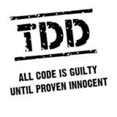
Test Driving ASP.NET MVC
Keith Burnell
Senior Software Engineer II
Email: keith@dotnetdevdude.com
Twitter: keburnell
Blog: www.DotNetDevDude.com

Slide 2
Little about me
Microsoft Web MVP
Senior Software Engineer II at Skyline Technologies
Been developing software for over 10 years
Primary focus on the Microsoft Web stack.
Local/Regional/National Speaker
Author (MSDN, Pluralsight)
President of Fox Valley .NET UG.
Notes:
Scrum most popular.

Slide 3
What’s on Tap
What is and what is not test-driven development
Unit testing
Concepts and strategies you need to know
Laying out and naming your stuff
DI/IoC and Test Dummies
MVC
Routing: What it is and how to test it
Controllers: Isolating and testing
Automated UI Testing
Notes:
Scrum most popular.

Slide 4
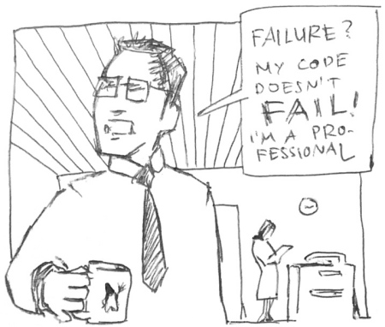
Do I Really Need To Be Doing Test-driven Development?
Notes:
Short answer is “YES”
If you are here hopefully you agree or your mind is at least open to the idea.
My goal is
show you that with out a doubt you should be doing TDD
And once I have brain-washed, err, convinced you - Arm you with the knowledge to spread the word

Slide 5


Slide 6

Ever have to deal with Spaghetti Code?
Notes:
I think there are 2 types of spaghetti code
Tangled mess code
Long code

Slide 7
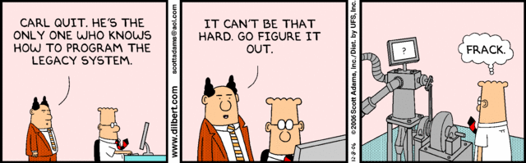
Ever inherit Legacy Code?
Notes:
Don’t deny it every company has at least 1 notorious app
The one where you always eager to pass off to the new guy

Slide 8

Ever scared to make changes?
Notes:
Ever get a change request that the minute you read you realize the even though the change would require 10 minutes that the effected piece of code is touched by 10,000 other pieces of code and testing will take 6 months
Have fun explaining that to the business ☺

Slide 9
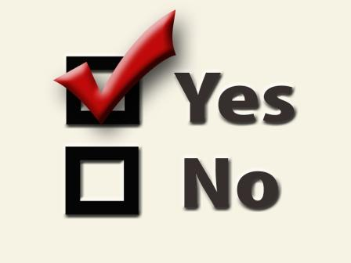
If you answered yes to any of those questions
Then…
Notes:
If you didn’t answer yes to any of these questions I will give you my business card because I want to work where you work.

Slide 10

Notes:
You need a way to alleviate the pain and hassle that comes with unmanageable overly complex poorly architected code
More importantly you need a methodology or set of practices that encourages writing better, cleaner, and more concise code

Slide 11
Types of testing that are not keys to test-driven development
Notes:
These types of testing are all VERY important
And implementing TDD does not reduce or remove the need for these types of
testing
What it does is significantly reduce the time spent in these testing cycles by
Reducing the number of bugs
Reducing the time needed to resolve bugs

Slide 12

Integration Testing
Notes:
The act of testing 2 or more interconnected pieces of a software system
Necessary evil…but once everything has been unit tested
Can have external dependencies (DB, Services, File System, Hardware, etc.)
Typically run longer than unit tests
Often require setup of resources
Harder to automate
For all those reasons they are run less often

Slide 13
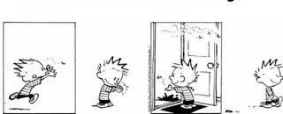
Regression Testing
1 Bug
> 1 Bugs
Notes:
The act of testing the entire software system after applying changes to ensure they did not affect other parts of the system
Complete end – to – end system test
Usually manual

Slide 14
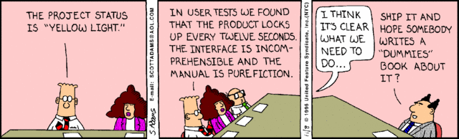
User Acceptance Testing (UAT)
Notes:
The act of testing to make sure system does what the users expect it to do
Lots of users in a room doing whatever it is they do
Manual
Time consuming
Stressful for you and the users

Slide 15

Performance Testing
Notes:
The act of testing to ensure the system meets the performance requirements defined in the SLA.
Test runs are automated but script creation is manual and time consuming
Requires separate data for performing tests
Tooling is expensive

Slide 16

Load Testing
Notes:
The act of testing how the system behaves under load
Automated
Tooling is expensive
Setup is time consuming

Slide 17
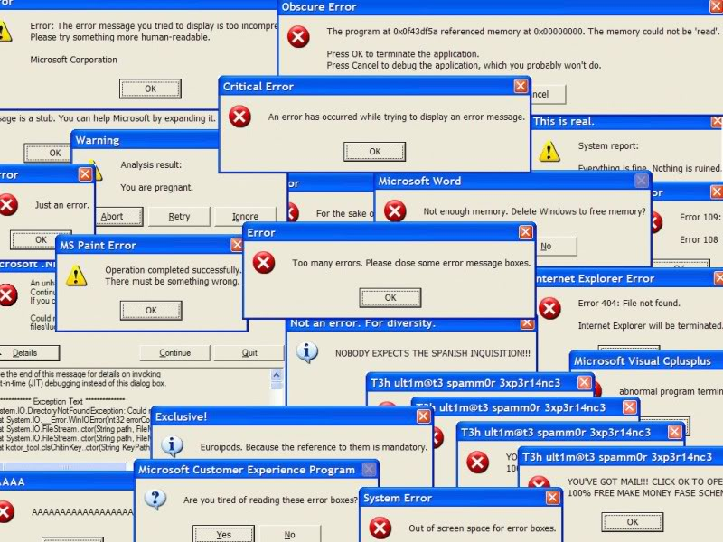
Stress Testing
Notes:
The act of testing the system fails and verifying how the system responds is acceptable
Requires effort to get the system to fail
Typically for verifying error messages and data state are valid during failures
Automated to make system fail, but requires manual verification

Slide 18
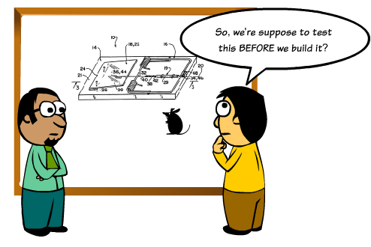
What is Test-driven Development?
Notes:
Test-driven development (TDD) is a software development process that relies on the repetition of a very short development cycle: first the developer writes a failing automated test case that defines a desired improvement or new function, then produces code to pass that test and finally refactors the new code to acceptable standards.
Often referred to Test-First Development
Process of writing tests before writing code
Kent Beck, is credited with having developed or 'rediscovered' the technique

Slide 19
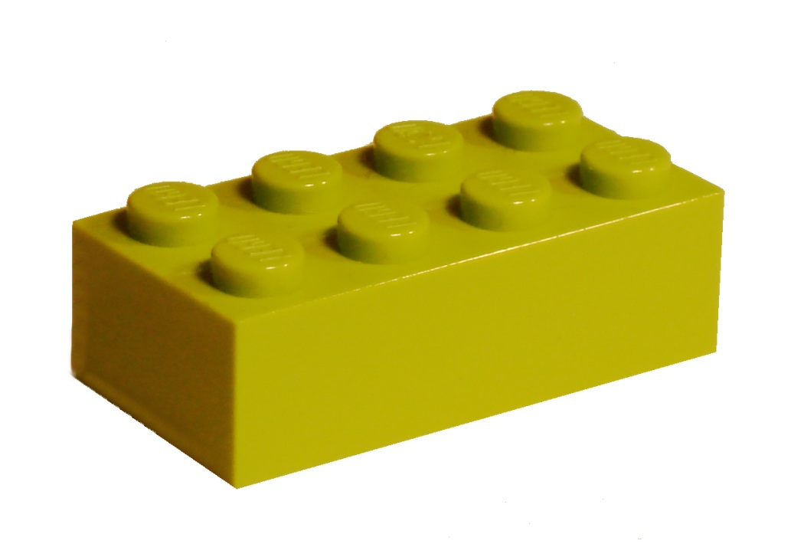
Unit Testing: Key to TDD
Notes:
The act of testing piece of code, usually a method, that tests a very small piece of functionality by invoking it and verifying assumptions

Slide 20
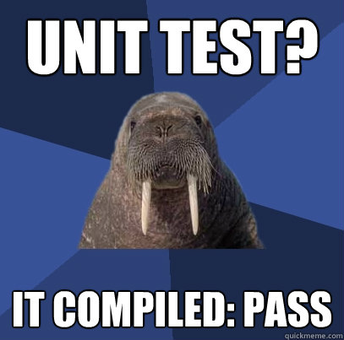
What makes a good Unit Test?
Automated and Repeatable
Easy to implement
Run on demand at the push of a button
Fast
Isolated
Notes:
So what are the characteristics of a good unit test
It is very easy to write bad unit tests
Bad unit tests are worse than no unit tests
They provide a false sense of security
They provide false system documentation

Slide 21
Important Concepts & Strategies
Notes:
Scrum most popular.

Slide 22
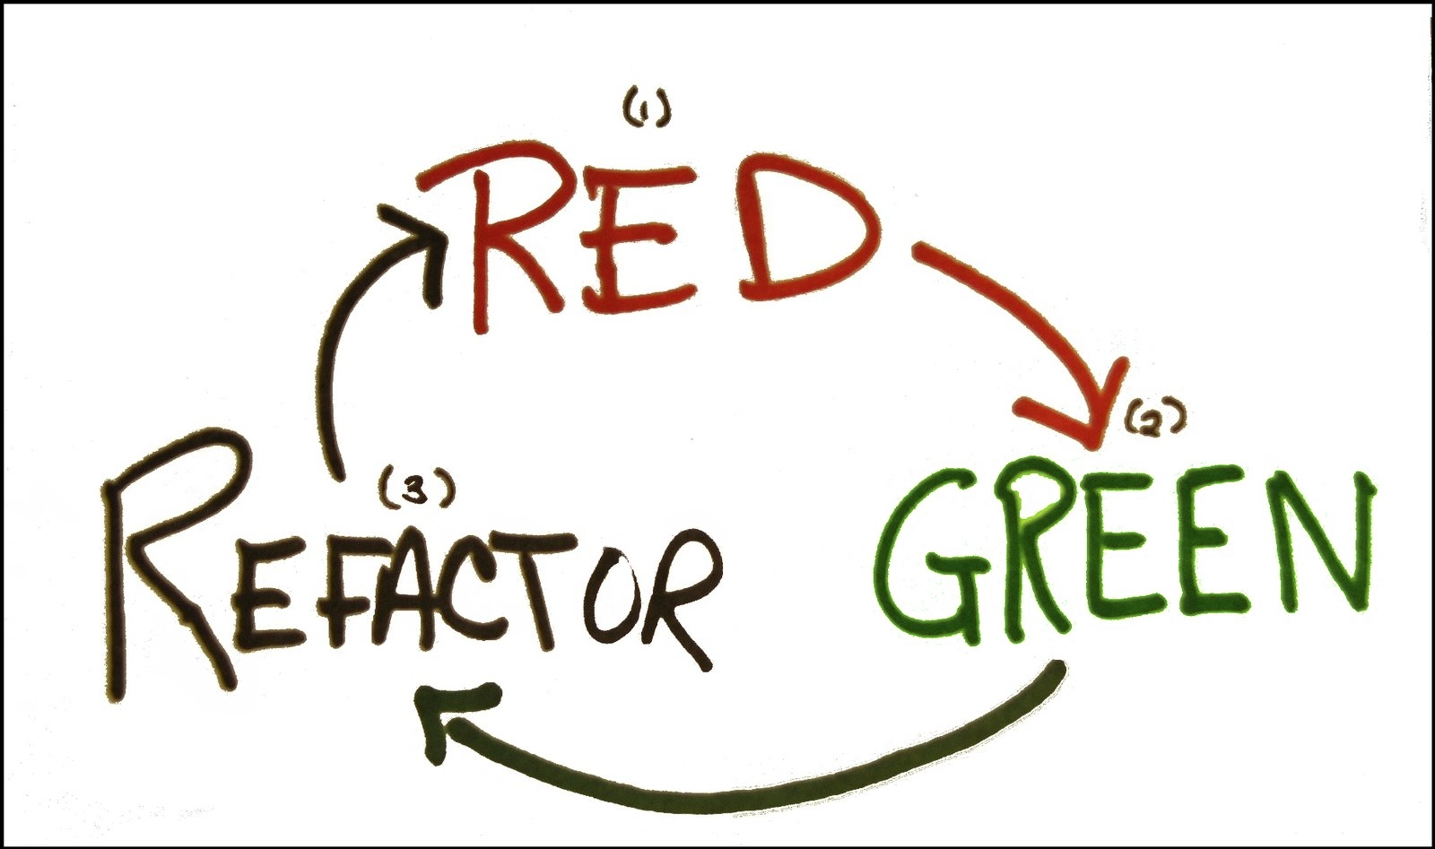
Notes:
Red
Write a failing test
Green
Write just enough code to get the test to pass
Refactor
Clean up the code

Slide 23
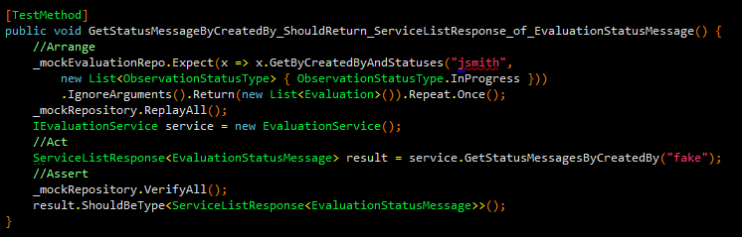
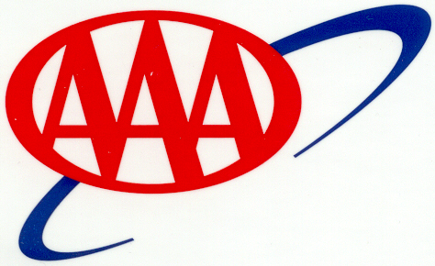
Arrange – Act - Assert
Notes:
Arrange
Set up mocks/stubs/fakes
Instantiate class under test
Act
Call the method being tested
Assert
Validate expected outcomes

Slide 24
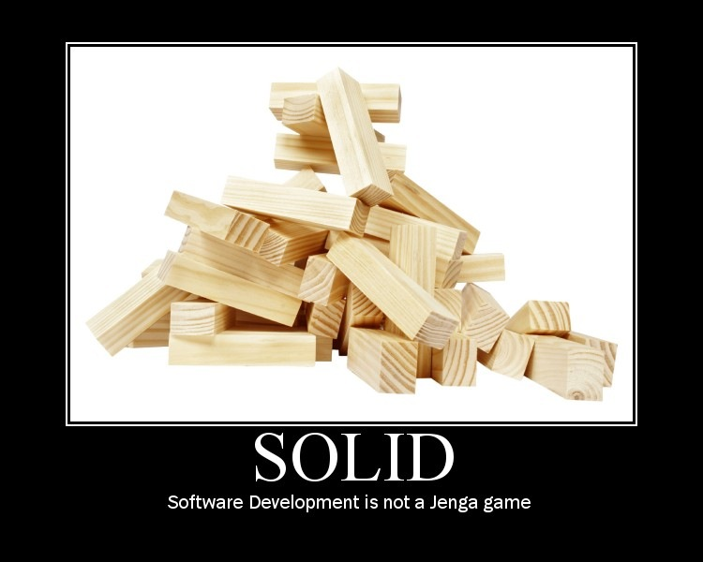
SOLID Principles of Software Development
Notes:
Collection of best-practice object-oriented design principles
Uncle Bob

Slide 25
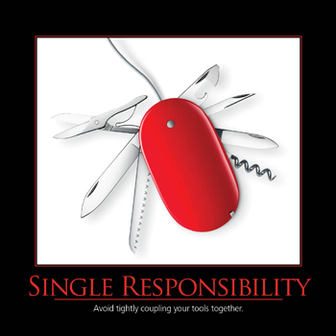
Single Responsibility Principle
Notes:
Should never be more than one reason for a class to change
A class should have one and only one responsibility
A method should have one and only responsibility
“And” in method names
Long methods

Slide 26

Open Closed Principle
Notes:
Classes should be open to extension and closed to modifications
Public signatures are contracts – Don’t break them!
Sealed classes are bad!

Slide 27
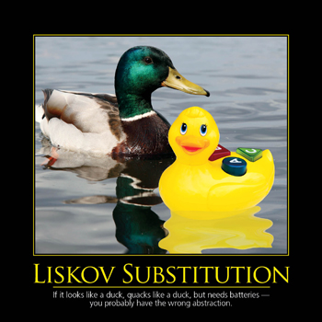
Liskov Substitution Principle
Notes:
References to base classes must be able to use derived classes without knowing it.

Slide 28
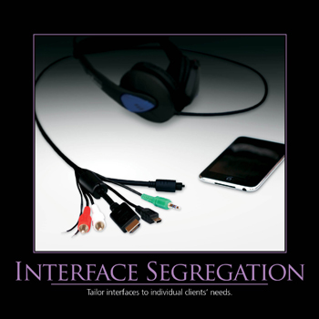
Interface Segregation Principle
Notes:
Interfaces should be fine grained
Interfaces should be client specific
Don’t agree with fine grain

Slide 29
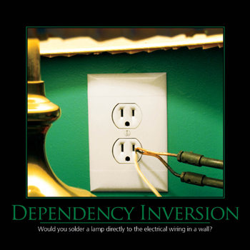
Dependency Inversion Principle
Notes:
Program to Interfaces not Concrete implementations
So when ‘newing up’ use IFoo and not Foo!

Slide 30
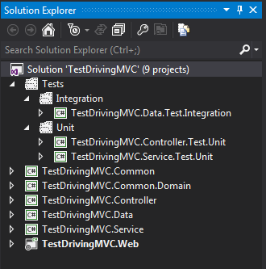
Example Solution Layout
Notes:
Tests should be isolated from the actual code!
Different types of tests should be isolated from other types to allow easily running a group of tests.
Tests should be placed in projects named the same as the project they are testing with a prefix of the type of tests it contains.

Slide 31

Naming Your Tests
Notes:
Be descriptive…very descriptive
Long test names are encouraged
Should be able to read a test name and know exactly what it does and more importantly why it would fail

Slide 32
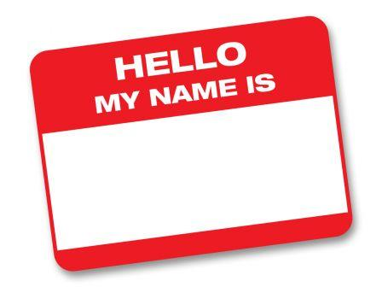
How I Name My Tests
[MethodUnderTest]_[ExpectedResult]_[Conditions]
GetCustomers_ShouldReturn_ListOf_Customers()
CalculateRate_ShouldReturn_25_When_Interest_Is_50_And_X_Is_5()
Notes:
Scrum most popular.

Slide 33
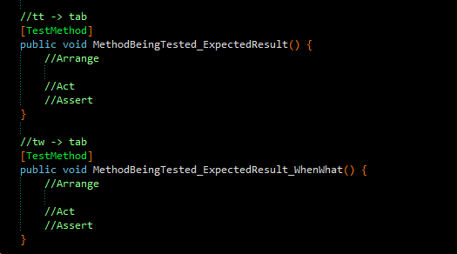
Resharper Live Template for Naming Tests
My unit testing live template is available on my blog:
http://bit.ly/OAOLK9
Notes:
Rehsarper Live Templates are similar to code snippets

Slide 34
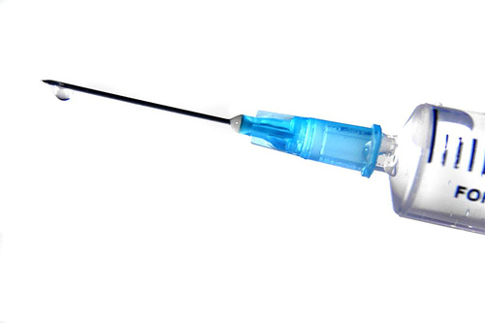
Dependency Injection (DI)
Notes:
The act of “injecting” the dependency’s a class needs.
3 types
Constructor
Property
Interface (really used along with constructor and property, passing in interfaces)

Slide 35

Inversion of Control (IoC)
Notes:
Class doesn’t go out and instantiate/”new up” its dependency’s…it is given them
All it knows is the method signatures it needs

Slide 36
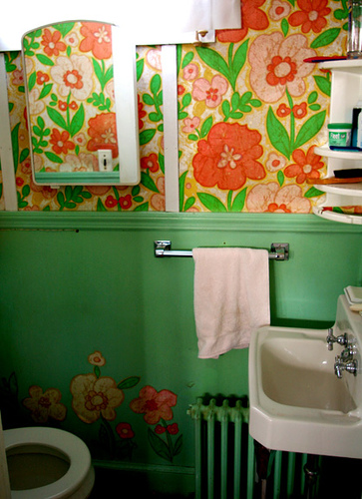
Non-programming Example of IoC
Simple Scenario: Your having a bathroom remodeled
Remodel Bathroom: $10,000.00
Notes:
Doesn’t work very well in the real world ----but works awesome in the development world!

Slide 37

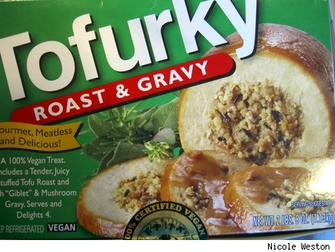
What does implementing DI/IoC get me?
Notes:
Seperation of Concerns
Mockability

Slide 38
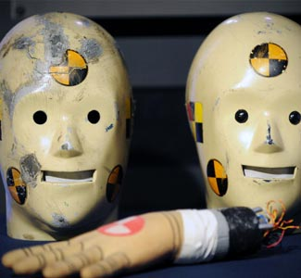
Test Dummies
Notes:
So let’s talk about how we can take advantage of our now nicely decoupled code to write true unit tests
Reminder: a true unit test tests a single small piece of functionality and has absolutely no dependencies
So we introduced DI/IoC and now have the ability to swap out our dependencies…but what do we swap them out??
We swap them out with Test Dummies (aka Test Doubles). Stand ins that allow us to provide the minimal functionality required for our test to continue processing
There are 2 basic types… [NEXT SLIDE]

Slide 39
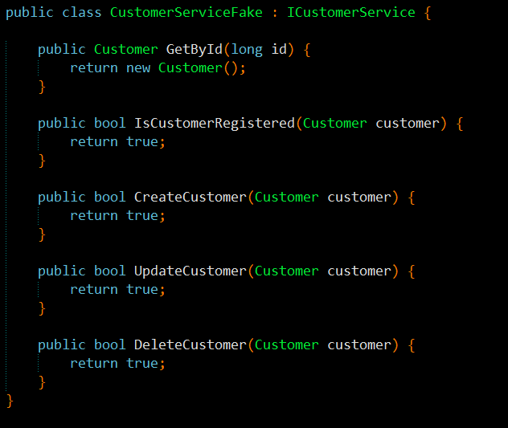
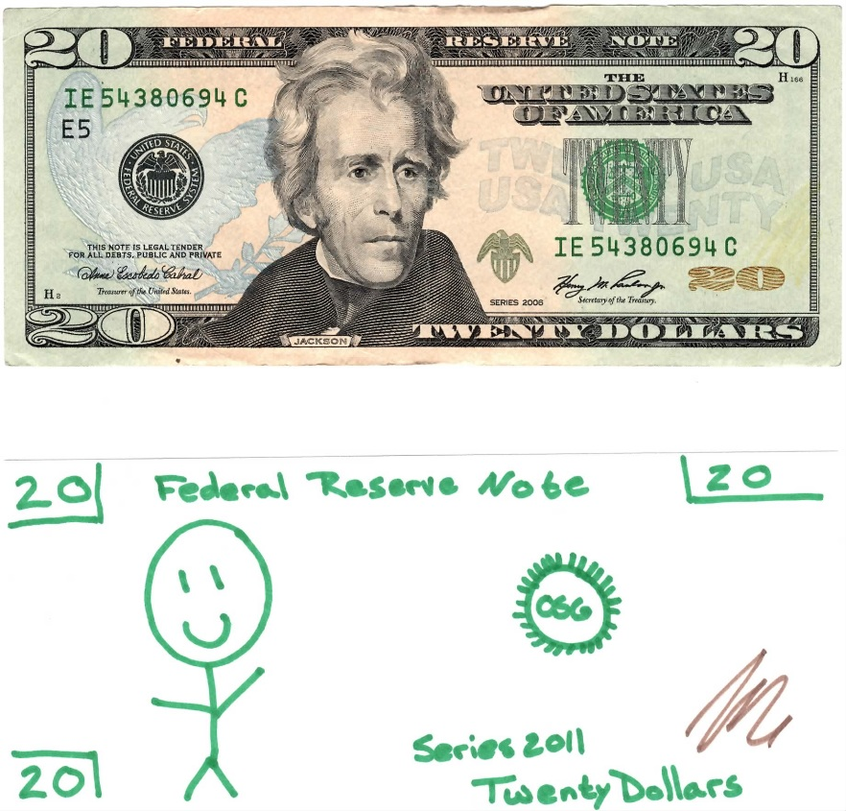
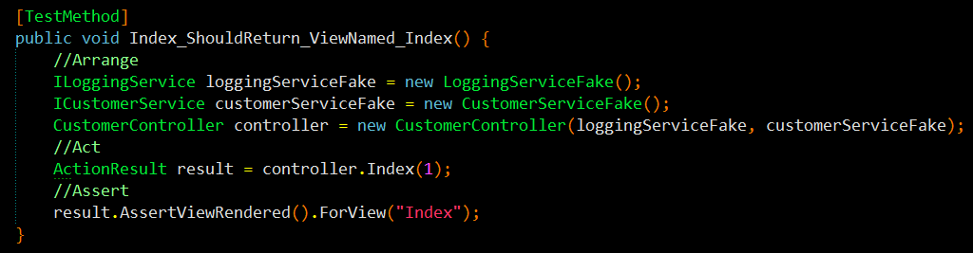
Fakes/Stubs
Notes:
The first type is Fakes or sometimes called stubs
Requires no tooling : Roll Your Own [CLICK]
Shell of a class that satisfies the implementation of the class (Implements the Interface)
Does nothing but return hard coded values![CLICK]
Not asserted against, state is never validated!

Slide 40
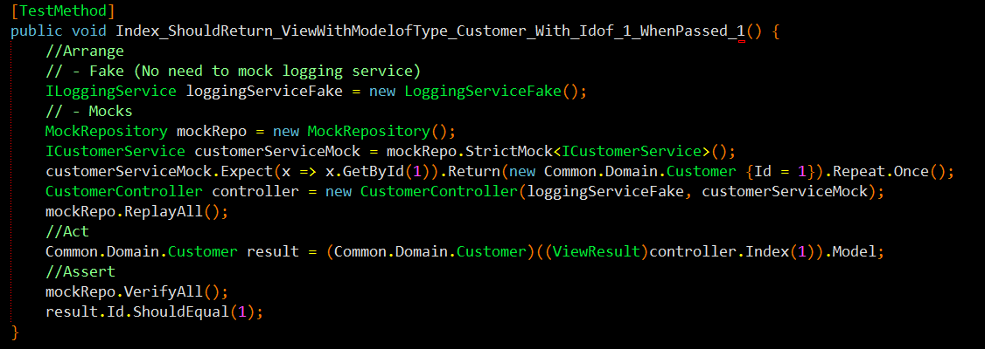

Mocks
Notes:
The second type are Mocks
Mocks require tooling and there is a ton of tooling available….but not a Microsoft offering
So what is a mock?
Like a fake it is a Simulated object that satisfies the implementation of the class
But unlike a fake it Mimics the objects behavior in a controlled manner
And it is Asserted against (state is validated)
There are two types of Mocks
Dynamic
Strict
Let’s take a look at a mock implementation using RhinoMock [CLICK]
No need to mock LoggingService
But we need to Mock the Customer Service
MockRepository – is the context used by Rhino Mocks
Create our strict mock
Set our expectations
Create the controller and pass the fake and the mock
Replay! This tells Rhino to replay all the expectations internally so it has a point of reference later
Call our method under test
VerifyAll – verifies all our expectations where met
Jump to code and run the test
Pass
Change expectation and rerun - FAIL

Slide 41
Benefits of Test Dummies
No waiting
Endless scenarios
Notes:
How many of you have ever had to wait for another developer, team, or even company to finish a dependency before you could continue coding?
With Test Dummies you no longer have to.
Endless Scenarios
You no longer have to beg some BA to create data scenarios for you, or worse yet create them yourself
And you don’t have to worry about the data only being there, in the state you need it in for 10 seconds
You have the ability to create any data scenario you need and to have it on hand at all times

Slide 42

Separation of Concerns
MVC = Model – View - Controller
Controller
(Input)
View
(Presentation)
Model
(Logic)
Notes:
Estimated Time: 2 minutes
MVC is a design pattern that stands for Model-View-Controller. What it strives to do is separate the concerns of an application’s presentation layer by assigning specific roles to the three different components.
[CLICK]
The Controller is responsible for handling all user input. Once input has been received, the Controller will perform any operations/actions it needs to, which might include interacting with the Model.
[CLICK]
The Model represents the core concern/logic of the application. Once the Controller retrieves some model data and performs any work with the model/etc it needs to it constructs a presentation model that describes the model in terms the View can understand.
[CLICK]
The View is the visual representation of the model. It presents the model data to the actual user in a way that is meaningful. In a web application, this would typically be HTML.
With these three pieces in place, your presentation layer becomes cleanly separated in such a way that each component can be developed/tested independently.
[CLICK]
Separation of Concerns!

Slide 43
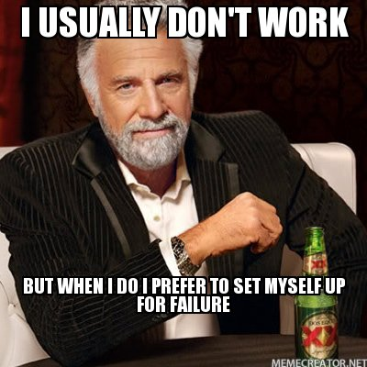
Created with Best Practices in Mind
Notes:
ASP.NET MVC was created with a clear focus on best practices in both Architecture and Coding
This is a new approach for Microsoft – in the past they always set us up for failure and it was our job to know better
In ASP.NET MVC:
1. There is a clear separation of layers (Model/View/Controller)
2. No designer!
3. No server controls that you can drag on and hook up directly to your Database!
4. They are actually encouraging testing…WHAT?
- Don’t believe me…File -> New Project -> ASP.NET -> “Create a unit test project”….Grant it, it should be defaulted to checked…but Rome was Built in a day
5. MVC has a lot of DI points [Next Slide]

Slide 44
Supported DI Points in ASP.NET MVC
Controllers
registering & injecting controller factories
injecting controllers
Views
registering & injecting view engines
injecting dependencies into view pages
Action Filters
locating & injecting filters
Model Binders
registering & injecting
Value Providers
registering & injecting
Validation Providers
registering & injecting
Model metadata Providers
registering & injecting
Notes:
ASP.NET MVC has a bunch of supported DI points. Not only does this allow you to architect correctly it allows you to plug in non Microsoft tooling

Slide 45

Routing
Handles the incoming request
Maps to controller and action
Can get crazy complex
Notes:
Routing is what makes clean readable url’s in MVC possible.
Handles the incoming request and maps that to a controller and action based on the URL segments
Can get complicated and confusing, luckily they can be tested
Let’s look at a demo of that now.

Slide 46

Demo: Testing your Routes
Notes:
Testing your routes
For testing of my routes and controllers which you will see in a bit I am going to use MVCContrib and specifically the MvcContrib Test Helper
You can find out more about MvcContrib at MvcContrib.codeplex.com
NuGet MvcContrib.MVC3.TestHelper (don’t install – already installed)
Pull up RouteConfig.cs – this has changed a bit since MVC3 where the routes used to be defined directly in the Global.ascx
Out of the box the Routes are defined directly in the RegisterRoutes method.
Now I could still test my routes in my unit tests by creating a new collection of routes and adding the same routes I have created here
But that is duplication of work and in the end I am not 100% certain that I am testing the same routes
And since the order of routes make a huge difference, most specific first and general last, I want to make sure that I am testing exactly what will be used
[Comment out “Out of the box” implementation and replace with “RouteProvider”
So, I created an abstraction on top of this to allow me use the same routes in my tests that I use in my app
Otherwise if I was registering my routes the way it is done out of the box I would not be able to use the same implementation in my tests
Open RouteTester
- Look at the usage of the RouteProvider
Create a test for the default route:
[TestMethod]
public void RequestGoingTo_Whack_ShouldMapTo_Customer_Index() {
//Arrange
string url = "~/";
//Act & Assert
url.ShouldMapTo<CustomerController>(action => action.Index(1));
}
Test for ignore
[TestMethod]
public void RequestTo_Wack_TraceAxd_ShouldBe_Ignored() {
//Arrange
string url = "~/trace.axd";
//Act & Assert
url.ShouldBeIgnored();
}

Slide 47

Controller
Thin and light weight
Loosely coupled
Things to test:
Takes correct action
Includes the right stuff
Notes:
Very little logic
Glorified traffic cop that directs input from the view either down the service road and back to the view, in a different direction (redirect, etc), or to turn around if invalid
Loosely coupled
Dependencies should be injected
Things to be tested
Takes Correct Action
Redirects to the correct view
Returns correct view
Includes correct model

Slide 48
Demo: Isolating and Testing a Controller
Notes:
Isolating the Controller
Talk about DependencyResolver and StructureMap
* Why I rolled my own!
Talk about application structure
Common -> Interfaces -> ICustomerService
Service -> CustomerService
Controller Project
Yes, I put my controller’s in their own project…explain why
Show Global.asax.cs and how controller project is handled with routing [namespace]
CustomerController
With my current architecture - every controller will need an ILoggingService and an I[controller name]Service
I am using StructureMap as my IoC Container, but that requires me to wire up my dependencies one by one
What if there was a way to not have to wire up the dependencies manually for each controller?
Custom Controller Factory
Out of the box the default controller factory just resolves controllers using the default naming convention
You can create a custom controller factory to add functionality and/or override the default functionality
In this case we are going to pimp out the default controller factory with StructureMap
Explain GetControllerInstance
Show how we are using StructureMap and the IContainer
And we need to tell ASP.NET MVC to use the Custom Controller Factory
Global.asax.cs
private void SetControllerFactory() {
ControllerBuilder.Current.SetControllerFactory(new ControllerFactory());
}
SetControllerFactory(); **** After WireUpDependencyInjection();
And then change the Customer Controller to accept the 2 dependencies as inputs
That’s it the combination of ASP.NET MVC and having a StructureMap container in our Controller Factory allows our controllers to automatically resolve their dependencies!
Set a breakpoint in CustomerController.Index to prove it.
Testing the Controller
Open the controller test class, talk about the usage of fakes
In order to test that the correct view is being returned or we are redirecting as necessary or the correct model is being returned we could write some really ugly low-level code that interrogates the controller context…or we could use MVCContrib
NuGet MvcContrib.MVC3.TestHelper (don’t install – already installed)
So let’s test that our Index controller method returns a view named “Index”
[TestMethod]
public void Index_ShouldReturn_ViewNamed_Index() {
//Arrange
CustomerController controller = new CustomerController(_loggingService, _customerService);
//Act
ActionResult result = controller.Index(1);
//Assert
result.AssertViewRendered().ForView("Index");
}
And now we can write a test to make sure the model being returned is the correct type
[TestMethod]
public void Index_ShouldReturn_ViewWithModelofType_Customer() {
//Arrange
CustomerController controller = new CustomerController(_loggingService, _customerService);
//Act
ActionResult result = controller.Index(1);
//Assert
Assert.IsInstanceOfType(((ViewResult) result).Model, typeof (Common.Domain.Customer));
}
Assert…blah blah blah, hard to read!
Should Assertion Library – user readable assertions
((ViewResult) result).Model.ShouldBeType<Common.Domain.Customer>();
Lastly we can test the redirect on our Post
[TestMethod]
public void IndexPost_ShouldRedirectTo_Step2() {
//Arrange
CustomerController controller = new CustomerController(_loggingServiceFake, _customerServiceFake);
//Act
ActionResult result = controller.Index(new Common.Domain.Customer {Id = 1});
//Assert
result.AssertActionRedirect().ToAction("Step2");
}

Slide 49
WatiN: Automated UI Testing
Automate the browser from your tests
Supports IE and FireFox
Allows you test
Navigation
Display logic (visible, etc)
Dialogs
Free
Notes:
Allows you to enter text in input fields, click radio buttons, submit forms, click links, etc.

Slide 50
Demo: WatiN
Notes:
Automated UI Testing w/ WatiN
Already done – but tell them : Install via NuGet and Change the EmbedInteropType to FALSE!!!!!
Create a test for “CustomerIndex_ShouldBeDisplayed_AsThe_DefaultPage”
The first thing we need is a url:
Point out common url field and Setup
The core of WatiN are the browser objects “IE” and “FireFox”
And we declare a new instance and pass in the url
_browser = new IE(url);
At this point we can run this and see that just by declaring a browser and passing a url our site is spun up
Now we can finish our test by interrogating the browser object
In this case we want to verify that we are on the “Customer Index” page and we do that by looking at the title
Browser.Title.ShouldEqual(“Customer Index”);
Run the test – GREEN!
Prove that it works change the expected title and run again
You’ll notice our browser stays open and also that browser has a dispose method so let’s handle this – IN CleanUp!
browser.Close();
browser.Dispose();
What else can we do with WatiN?
How about making sure a field exists on the page…
- Let’s make sure the firstName field is displayed – we will use the browser dev tools to figure out what we are looking for
[TestMethod]
public void CustomerIndex_ShouldContain_DisplayFor_FirstName() {
//Arrange
IE browser = new IE(url);
//Act
Label result = _browser.Label(“firstName”);
//Assert
result.ShouldNotBeNull();
}
Let’s test our button
[TestMethod]
public void Clicking_Next_ShouldDisplayThe_Step2Page() {
//Arange
string url = "http://localhost:11074/";
//Act
IE browser = new IE(url);
browser.Button("next").Click();
//Assert
browser.Title.ShouldEqual("Step 2");
browser.Close();
browser.Dispose();
}
How about testing validation? Let’s make sure that our first name required message is displayed when clicking Create and with nothing in First Name
[TestMethod]
public void FirstNameIsRequired_ValidationMessage_ShouldBeDisplayed_WhenClickingCreate_WithoutFillingIn_FirstName_Field() {
//Arrange
_browser = new IE(Url);
_browser.Button("create").Click();
//Act
Span result = _browser.Span(Find.By("for","FirstName"));
//Assert
result.InnerHtml.ShouldEqual("First Name is required");
}
Now we can test the opposite: Message should not be displayed when we fill in First Name and click Create
[TestMethod]
public void FirstNameIsRequired_ValidationMessage_ShouldNotBeDisplayed_WhenClickingCreate_With_FirstName_Field_FilledIn() {
//Arrange
_browser = new IE(Url);
_browser.TextField("FirstName").TypeText("Joe");
_browser.Button("create").Click();
//Act
Span result = _browser.Span(Find.By("for", "FirstName"));
//Assert
result.Exists.ShouldBeFalse();
}

Slide 51

Slides and demos on GitHub
http://www.github.com/kburnell/TestDrivingASP.NETMVC

Slide 52
Other Resources
Test Driven Development: By Example (Kent Beck)
The Art of Unit Testing (Roy Osherove)
Roy Osherove’s Blog (http://www.osherove.com)
My Website (http://www.dotnetdevdude.com)
MSDN: Test-Driving ASP.NET MVC (http://bit.ly/MO0zXU)
Notes:
Scrum most popular.

Slide 53
Tools I Used and/or Talked About
NuGet (http://www.nuget.org)
ReSharper (http://www.jetbrains.com/resharper/)
Should Assertion Library (http://should.codeplex.com)
RhinoMocks (http://hibernatingrhinos.com/open-source/rhino-mocks
StructureMap (http://www.structuremap.net)
MvcContrib (http://mvccontrib.codeplex.com/)
WatiN (http://www.watin.org)
Notes:
Scrum most popular.

Slide 54

Notes:
Scrum most popular.

Slide 55
Thank You!
Questions?
Twitter: @keburnell
Blog: DotNetDevDude.com
Email: keith@DotNetDevDude.com
Notes:
Scrum most popular.

